Slide 1




CS6120
NLP
Optimizing Retrieval-Augmented Generation for Construction Management: An Ablation Study on Embedding and Generative Models
Akash Dhande (002086876)
Gargi Vipat (002068454)
Rohan Puntambekar (002300568)

Slide 2

INTRODUCTION
The construction industry’s growing project complexity and strict safety regulations often overwhelm traditional manual monitoring and reporting methods.
Massive volumes of technical specifications, regulations, and unstructured data impede swift, accurate decision‑making.
Integrating generative AI through RAG models promises automated retrieval and contextual interpretation of domain documents, helping reduce decision making times significantly.

Slide 3
OBJECTIVE
Build a domain‑specific RAG system to automate retrieval of relevant safety standards and technical guidelines.
Conduct an ablation study on embedding and generative strategies to determine the most effective configuration.
Evaluate generative model outputs using BLEU and ROUGE metrics against a curated ground‑truth from Wendel specifications.

Slide 4
LITERATURE REVIEW
CONSTRUCTA Framework [1]: Combines Static RAG, Knowledge RAG, and Reinforcement Learning from Human Feedback to automate construction scheduling through context-aware retrieval and expert-aligned planning.
Entropy-Optimized Dynamic Text Segmentation (EDTS) [2]: Improves traditional retrieval by dynamically chunking construction documents into semantically coherent sections using entropy calculations for better information clarity.
AEC Q&A Advisor [3]: A RAG-based system reduces LLM hallucinations in technical document QA by combining advanced prompt design (e.g., CoT, Few-shot) with cosine similarity-based retrieval, outperforming traditional search tools.
[1] Yifan Zhang, Xue Yang (2025) CONSTRUCTA: Automating Commercial Construction Schedules in Fabrication Facilities with Large Language Models. arXiv:2502.12066v1 [cs.AI] 17 Feb 2025
[2] Haiyuan Wang, et al. (2025) Entropy-Optimized Dynamic Text Segmentation and RAG-Enhanced LLMs for Construction Engineering Knowledge Base. doi.org/10.3390/
[3] Yunshun Zhong, Tamer El-Diraby (2025) Generative project question answering system: triangulating three approaches for project authoring

Slide 5
LITERATURE REVIEW
Safety Knowledge Retrieval with RAG vs. Fine-Tuned LLM [4]: A comparative study showing RAG and fine-tuned models outperform GPT-4 in construction safety tasks, improving BLEU/ROUGE scores and reducing hallucinations using domain-specific prompts and embeddings.
RAG4CM System [5]: Introduces a knowledge graph-based RAG pipeline that chunks multimodal documents semantically and incorporates user-preference learning, achieving high accuracy in construction management information retrieval.
[4] Jungwon Lee et al. (2024) Performance comparison of retrieval-augmented generation and fine-tuned large language models for construction safety management knowledge retrieval doi.org/10.1016/j.autcon.2024.105846
[5] Chengke Wu et al. (2025) Retrieval augmented generation-driven information retrieval and question answering in construction management doi.org/10.1016/j.aei.2025.103158

Slide 6
DATASET DESCRIPTION
Utilized the Wendel specifications document on office building renovation, the dataset captures detailed construction processes, codes, and safety regulations.
The document’s consistent formatting and clear sectioning helps segment content and align each Q&A pair with its relevant section.
Organized as a CSV with columns for Question Type, Question, Answer, and Source Section, featuring factual, reasoning, and quantitative questions for comprehensive domain coverage.

Slide 7
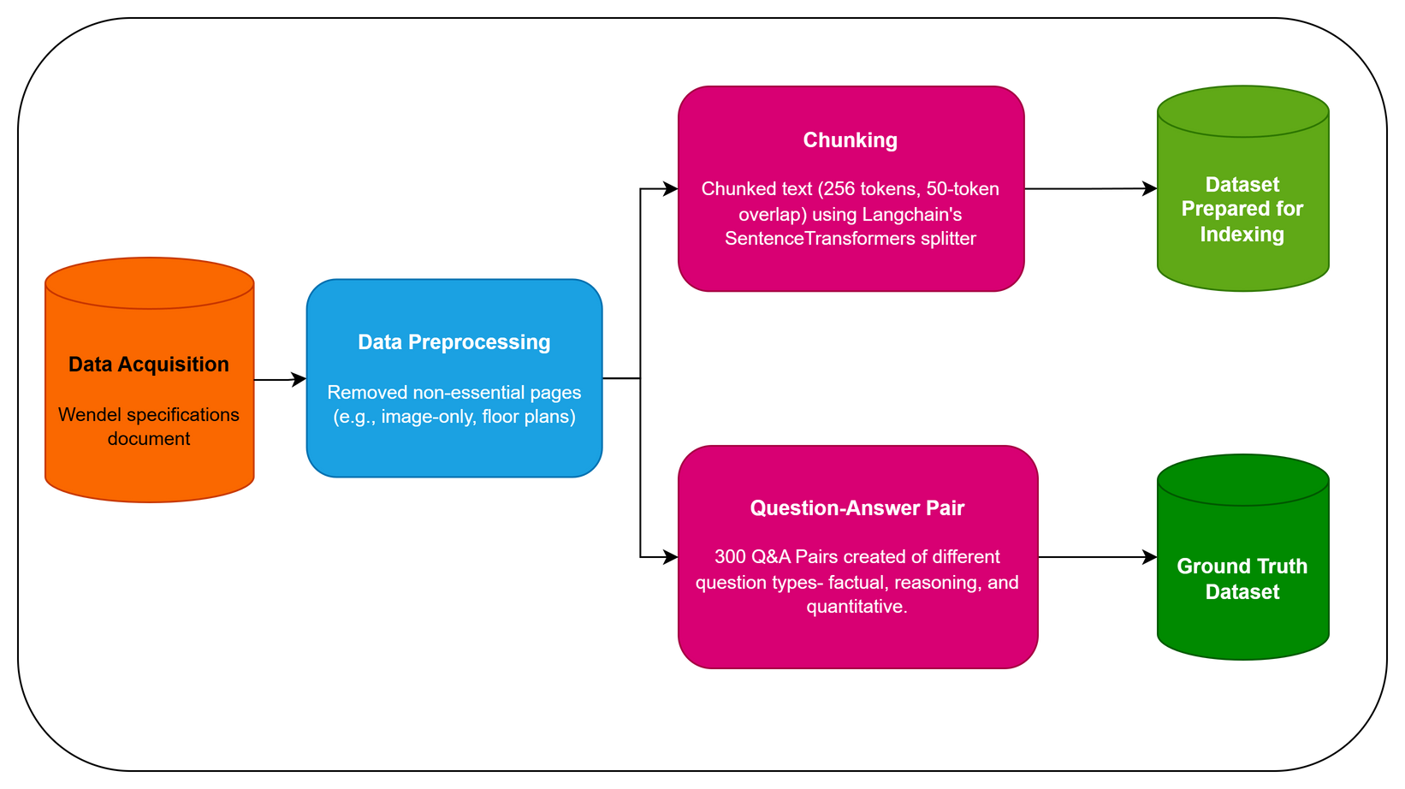
DATA PREPROCESSING & GROUND TRUTH GENERATION

Slide 8
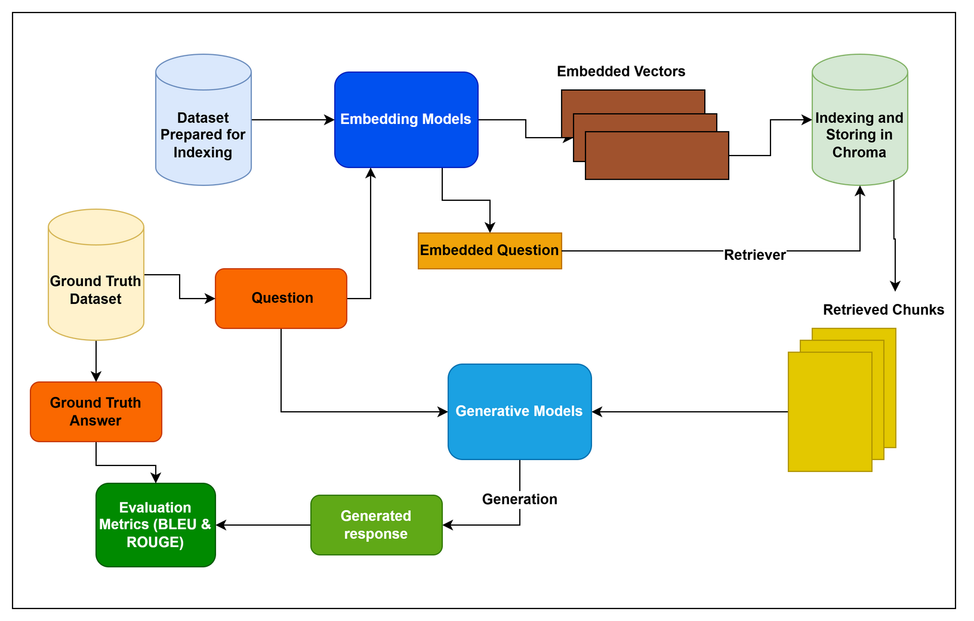
EXPERIMENTAL METHODOLOGY

Slide 9
EMBEDDING PIPELINE
IBM Granite Embedding 278M: Utilizes a BERT-based biencoder with 384-dimensional vectors, 6 blocks, 512-token context, and CLS pooling—designed for efficient, text-only encoding of standard-length inputs.
nomic-embed-text:latest: Built on a “nomic-bert” architecture, it supports longer contexts (up to 2048 tokens) with 12 blocks, 768-dimensional embeddings, 12 attention heads, and mean pooling, excelling in handling complex, lengthy passages.

Slide 10
GENERATION PIPELINE
Gemma Models: Evaluated gemma3:1b (1B params, 32K token context, BERT-inspired, resource-efficient) and gemma3:4b (4B params, 128K token context, multimodal, extended context).
DeepSeek Model: Assessed deepseek‐r1:7b (7B params, 131K token window, 28 attention heads) that distills reasoning from larger architectures.

Slide 11
EVALUATION PIPELINE
BLEU Score: It measures precision by evaluating how much of the generated text overlaps with the reference answer's wording and structure (n-gram match).
ROUGE Score: It complements this by measuring recall, assessing how much of the reference content is captured in the generated output (including ROUGE-N and ROUGE-L variants).

Slide 12
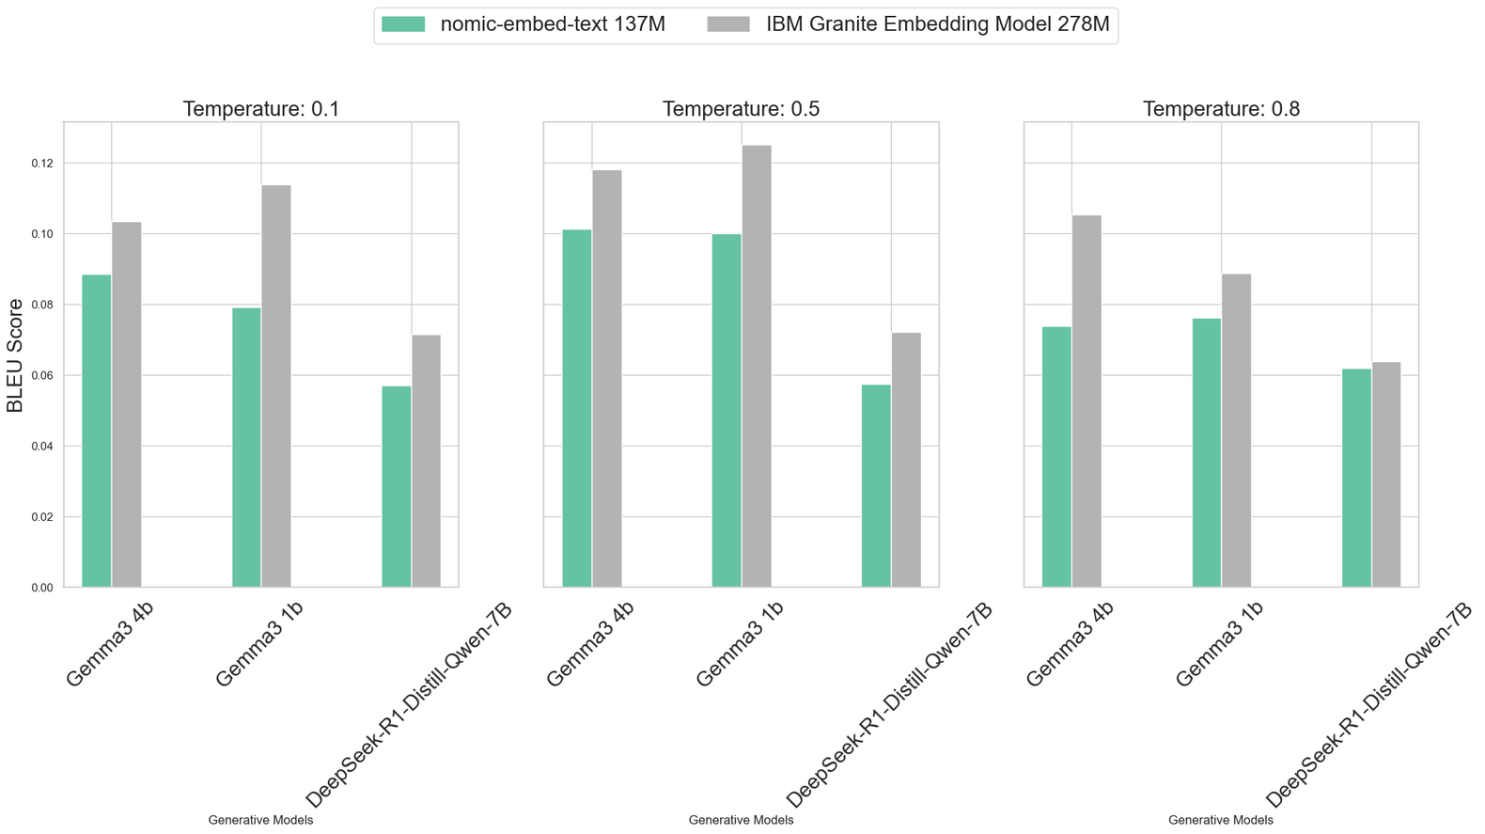
BLEU SCORES

Slide 13

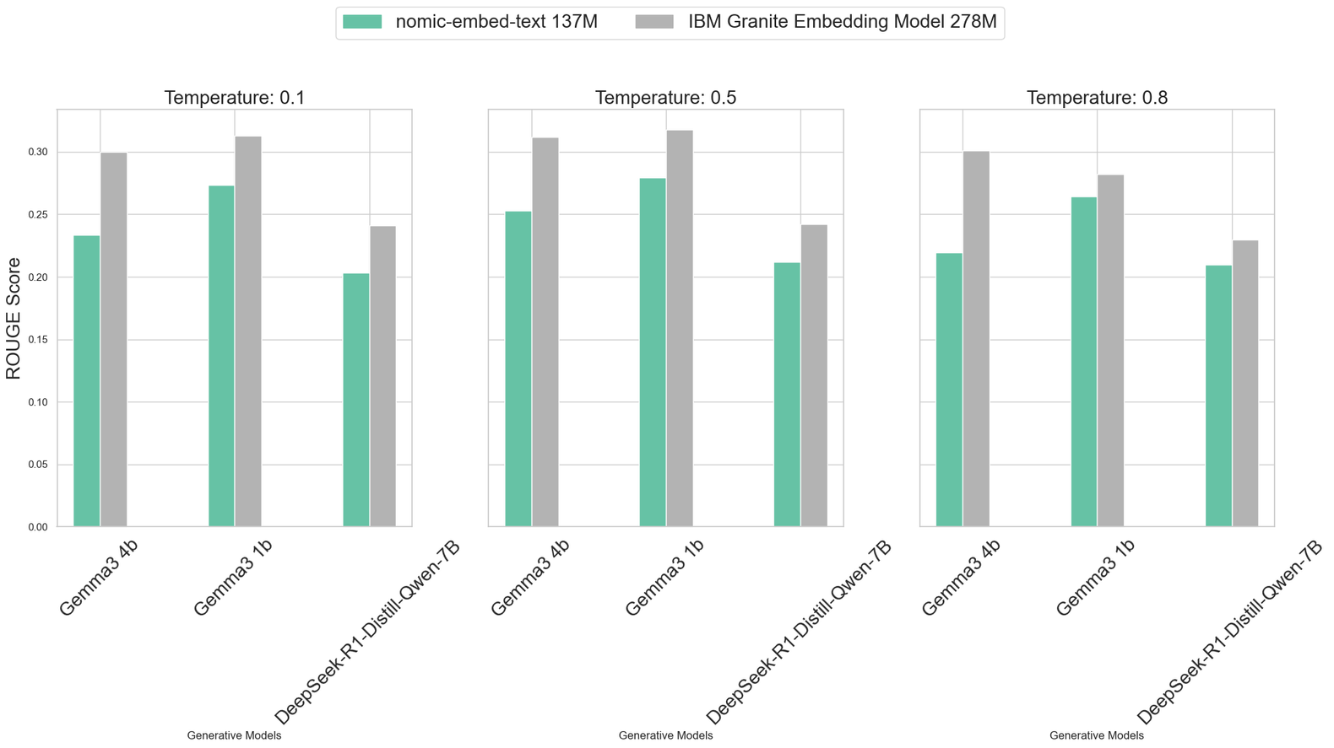
ROUGE SCORES

Slide 14
CONCLUSION
Best Performance Configuration: The IBM Granite Embedding Model (278M) combined with Gemma3 1b at a 0.5 temperature achieved the highest BLEU (0.1252) and ROUGE (0.3178) scores. Its BERT-based 384-dimensional embeddings captured semantics in construction texts better than nomic-embed-text 137M. Notably, the lighter Gemma3 1b sometimes outperformed larger models, offering focused and less noisy responses.
Impact of Temperature and Model Design: Temperature tuning was critical—0.5 struck the ideal balance between determinism and diversity. Lower values (0.1) led to overly rigid outputs; higher values (0.8) reduced precision and recall.

Slide 15
THANK YOU

